Slide 1
Digital Water Marking
Vidyavardhini’s College of Engineering & Technology
K.T. Marg, Vartak College Campus, Vasai Rd, Vasai-Virar, Maharashtra 401202
Department of Artificial Intiligence and Data Science
Group No:
Yash Patil (19)
Chetan Sapkal (39)
Shubhamkar Patra(37)
Project Guide: Ms.Neha Raut
Date: 3/11/2022

Slide 2
Contents
Introduction
Problem Statement
Literature Survey
Proposed System
Architecture/Framework/Block diagram/Algorithm/Process Design
Details of Hardware/Software used
Experiment and Result
Conclusion and Future work
References
Thank you

Slide 3
Introduction
Digital image watermarking is simply the digital watermarking of an image, which provides an alternative solution for ensuring tamper-resistance, the ownership of intellectual property, and reinforcing the security of multimedia documents. Any digital content, such as images, audio, and videos, can hide data.
This is a technique for allowing two or more people to silently communicate with each other by hiding any secret message on a media cover. Files used as media can be text, audio, image or digital video formats.
The secret message embedded in the media cover using the appropriate algorithm and demanding the steno file itself to be sent to the receiver.

Slide 4
Problem Statement
Steganography hides the very existence of a message so that if successful it generally attracts no suspicion at all. While Cryptography is more popular than steganography but in cryptography the encrypted letter could be seen by anyone i.e. cipher text. we proposed a LSB algorithm of an image steganography system to hide a digital text of a secret message. The main goal of this method, is to hide a text of a secret message in the pixels of the image in such a manner that the human visual system is not able to distinguish between the original and the stego-image.

Slide 5
Proposed system
The entire project is created using the Python. In proposed system LSB with Binary XORed is used. The basic reason of using this technique is to reduce image distortion. As in this technique watermarked data is stored only in 3 bits of each pixels maintaining transparency of image. Then binary XORed operation is performed on both data and secrete key. This provides stronger authentication or security as there are total 2²⁵⁶ permutation and combinations are required to break this encryption.

Slide 6
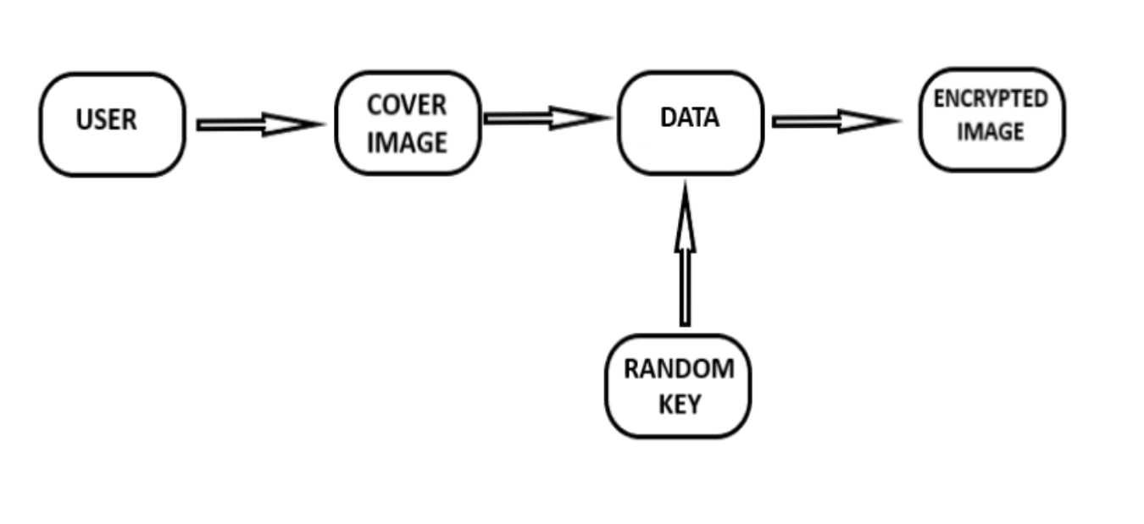
Process Design
Encryption Process:

Slide 7
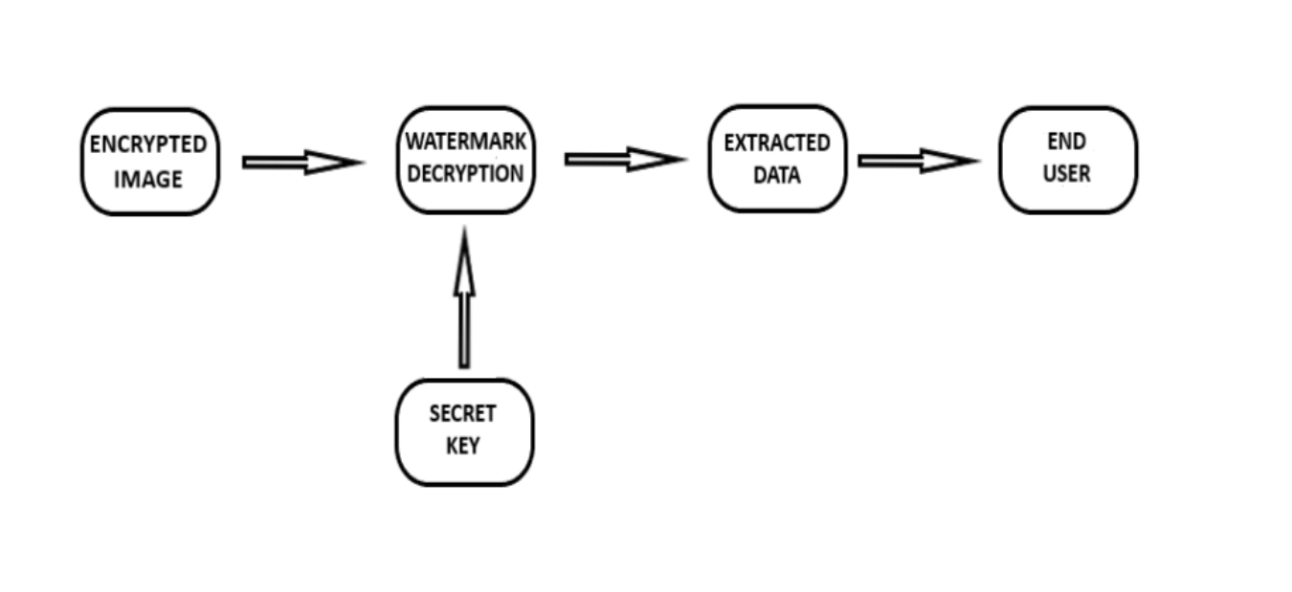
Process Design
Decryption Process:

Slide 8
Details of Hardware/Software used
Hardware Requirement:
Ø I3 Processor Based Computer or higher
Ø Memory: 2 GB RAM
Ø Hard Drive: 50 GB
Ø Monitor
Ø Internet Connection
Software Requirement:
Ø Windows 7 or higher
Ø Programming language: Python
Ø IDE used: Jupyter notebook
Ø Technology used: Steno ,Tkinter

Slide 9
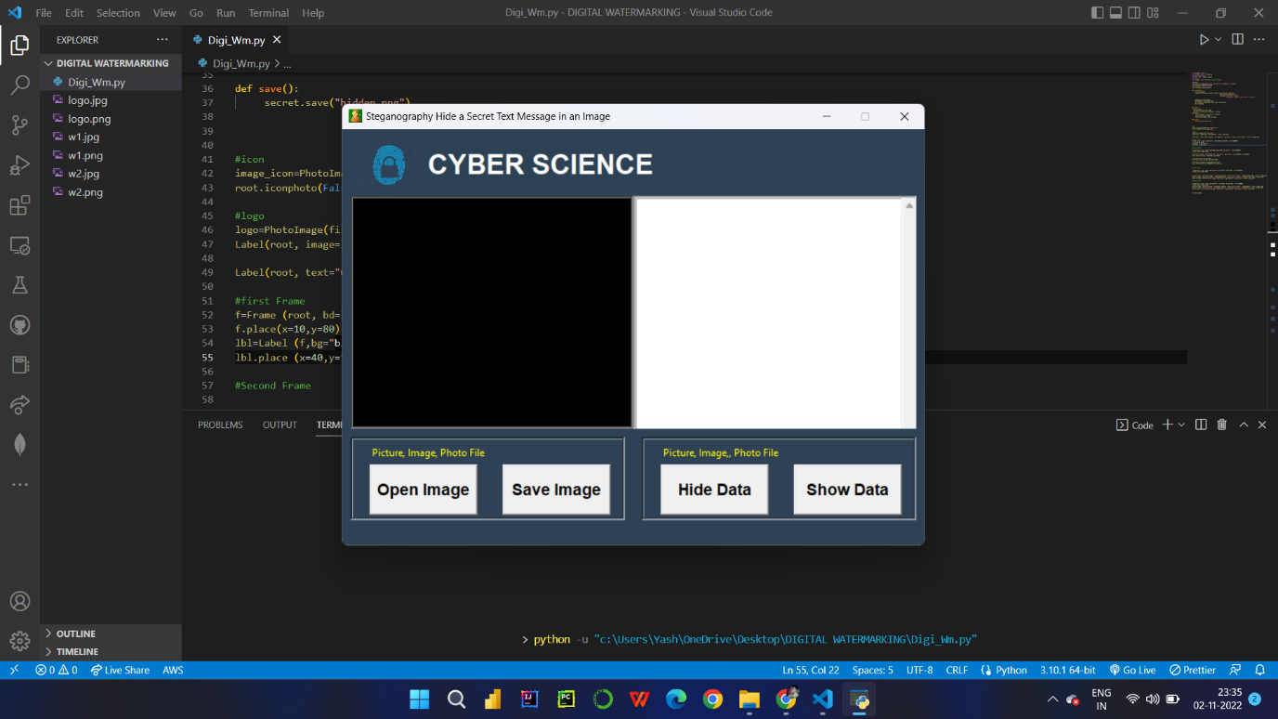
Experiment and Result

Slide 10
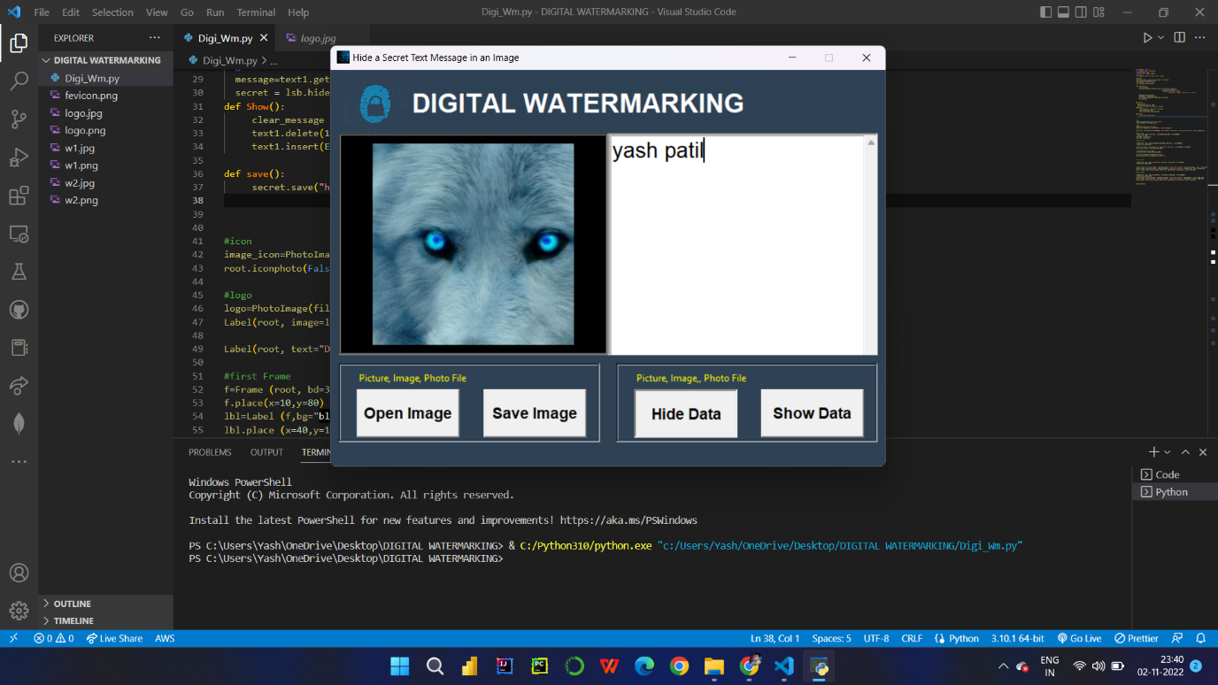
Experiment and Result

Slide 11
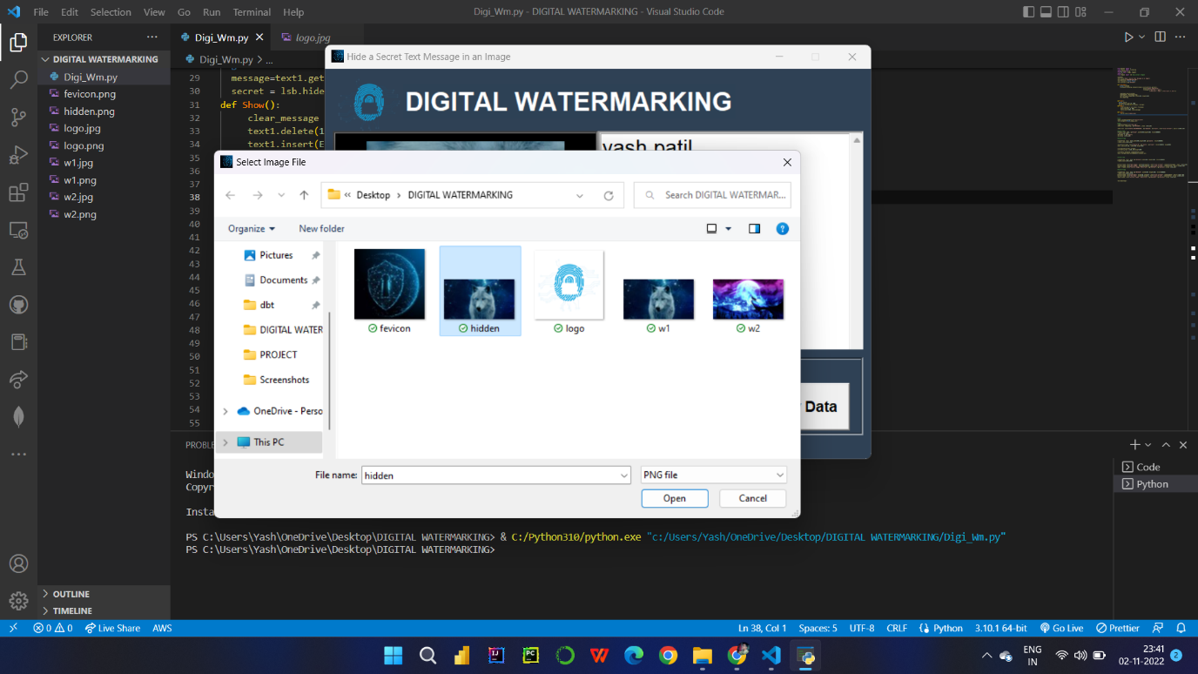
Experiment and Result

Slide 12

Experiment and Result

Slide 13
Conclusion and Future work
Watermarking is a method to protect the data and to authenticate the digital content. Watermarking is required due to the emergence of usage of internet in one’s day to day life. In Proposed system, mainly focused on Image distortion and Data recovery. To achieve this parameter, we using least significant Bit algorithm. Concentrating on image quality as equal importance is given to data as well as cover image. At receiver side original data is extracted without image distortion
Future Work:
This Project will be added with an Email facility.
Most and widely used platform for information exchange i.e., the email, providing this facility in system so that user can communication and transfer confidential data through email in secure way.

Slide 14
References
H. Lee, “Reversible Watermarking Exploitation Differential Histogram Modification with error Pre-compensation”, International Conference on Electronics, Information, and Communication (ICEIC), 2018.
S. Yi, Y. Zhou,” Adaptive code embedding for reversible data hiding in encrypted images”, IEEE International Conference on Image Processing (ICIP), 2017.
D. Hu, D. Zhao, S. Zheng, “A New Robust Approach for Reversible Database Watermarking With Distortion Control”, IEEE Transactions On Knowledge And Data Engineering, 2018.
S. A. Parah, G. M. Bhat, “Fragility evaluation of intermediate significant bit embedding (ISBE) based digital image watermarking scheme for content authentication”, International Conference on Advances in Electronics Computers and Communications, 2014.
B.Sridhar, Dr.C.Arun, “A Wavelet based Image Watermarking Technique using Image Sharing Method”, International Conference on Information Communication and Embedded Systems (ICICES), 2013.

Slide 15
Thank you

